Slide 1
The Role of Japanese CSOs in Promoting the SDGs
Ryokichi HIRONO, Professor Emeritus, Seikei University
At ACUNS Japan Forum Meeting
UNU, Tokyo
19 June, 2017

Slide 2
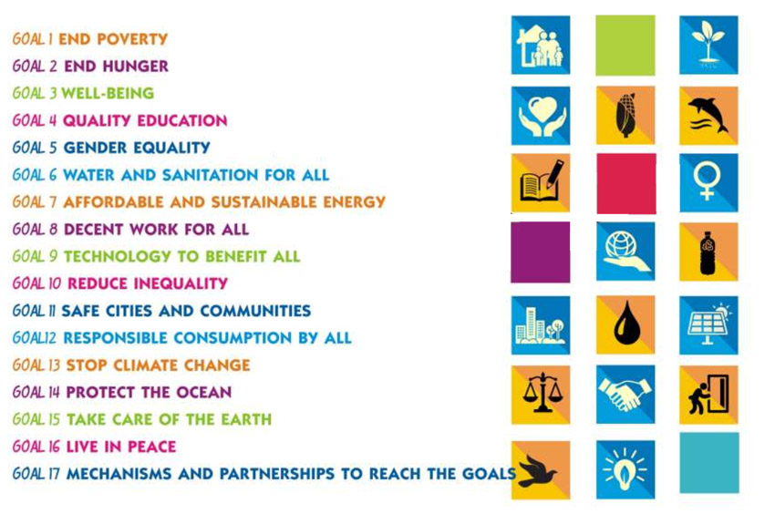
Introduction Societal Transformation has now begun:
from ＭＤGs 2001-15 to SDGs 2016-30

Slide 3
1. Self-reflections on Promoting the SDGs 2016-30: What have we learnt and not learnt enough from the Earth Summit, the MDGs 2001-15 and the UNDESD 2005-14 Implementation Processes
The Role of Japanese CSOs in Promoting the SDGs
a) Some Positive Impact of the various CSO Involvement in the process leading up to the Earth Summit and the Agenda 21 of 1992-2000, the MDGs 2001-15, the UNDESD 2005-14 and the SDGs 2016-30
i) Early installation of the CSO Network for SDGs for mobilizing the support among various stakeholders to the SDGs and for sustaining political and civic education at schools and communities across the country for their ownership;
ii) Participation of the CSO Network Japan in formulating the NIP and LIPs for SDGs at the central and local government levels for pressing respective governments to accelerate the formulation of the NIP and LIPs and their effective implementation in the light of changing local, national and global conditions and priorities;

Slide 4
b) Some Reflections on the Role of CSOs in Promoting the SDGs i) Inadequate linkages with, and learning from, the NGO forum for the Earth Summit, the Rio+10 and its subsequent ESD-J and the Rio+20 and and its subsequent multi-stakeholder forum: lack of solid foundation for promoting and implementing the SDGs; ii) Insufficient involvement of, and cooperation with, various CSOs in Japan, especially those engaged in the SDGs-related activities solely at home and those colleagues overseas actively engaged in achieving the SDGs in their respective communities and countries; iii) Lack of effective participation of the CSOs as a representative body, in contrast to the private sector and labour group, in the NIP and LIPs formulation process; iv) Lack of or inadequate CBOs ownership of the SDGs agenda in various local communities across the country, and; v) Funding problems;

Slide 5
2. Some Suggestions for Enhancing the Effective Contribution of Japanese CSOs in Promoting the SDGs and especially the NIP and LIPs Implementation
Let us mobilize all the stakeholders for promoting the SDGs on the basis of the United Nations Universal Declaration on Human Rights and based on the Principle of the Separation of Powers, the fundamental component of Democratic Regime at the local, national and global levels.
1) To the CSG Network Japan, in particular,
a) Mobilize a greater number of CSOs and CBOs into the Network and enhance effective participation of, and partnerships among, them by responding to diverse needs and requirements of its members both professionally and financially and representing them effectively not only at the NIP Council but vis-à-vis central and local governments through diverse channels;
b) Organize desk studies, on-the-site study tours, workshops and symposia in collaboration with academia, professional organizations, labour groups, private sector, local and central government stakeholders and international organizations in enhancing people participation in achieving SDGs at the local, national and global levels;
c) Collaborate with its members effectively in dialogue with various stakeholders in their respective fields of SDGs-related activities at the local, national and, if possible, at the global levels;

Slide 6
2) To the Executive Branch, among others, a) Work effectively with CSOs, CBOs and other stakeholders engaged in implementing the NIP and LIPs for enhancing the interest and commitment among the general public to achieving the SDGs, especially in accordance with their respective priorities; b) Increase the government assistance to CSOs and CBOs both administratively and financially, as JFGE has been doing vis-à-vis Environmental NGOs and NPOs since its founding in 1993; 3) To the Legislative Branch, especially, a) Install a special SDGs committee/subcommittee to oversee the Executive Branch for effective implementation of the SDGs and collaborate with all the stakeholders including CSOs and CBOs engaged in implementing the SDGs through public hearings and other consultative channels to facilitate effective NIP and LIPs implementation; b) Provide adequate funding to all stakeholders, especially CSOs and CBOs faced with poor administrative and financial capacity to assist them in the SDGs implementation by establishing foundations independent of the Executive Branch as in many developed countries, e.g., NED and FES; c) Monitor and evaluate the relevance, efficiency, outcome and impact of government policies, programmes and projects for SDGs, as well as all the publicly-funded CSOs and CBOs by installing an agency independent of the Executive Branch as in many developed countries, e.g., GAO and OAG.

Slide 7
Thank you for your kind attention and please send any further questions and comments to: hi_ryokichi@yahoo.co.jp

